Slide 1
进展
1. 增加接球方向的语言提示。
2. 阅读一篇VR+下肢平衡康复的论文。

Slide 2
The Effect of a Virtual Reality Game Intervention on Balance for Patients with Stroke: A Randomized Controlled Trial
Games for Health Journal
Impact Factor: 2.224

Slide 3
Introduction
1. Stroke affects independence in activities of daily living (ADL) by reducing postural control, resulting in slow walking speed and short stride length.
2. Stroke leads falls in 18% of patients every month, this may cause fall fear and affect ADL independence and quality of life (QOL).
3. Compared with traditional methods, the VR method can greatly increase motivation.
4. In this study, we investigated the effect of the Microsoft Kinect function for Xbox training plus traditional training on the balance ability of patients with chronic stroke.

Slide 4
Materials and Methods
1. Participants
(1) 50 patients
(2) Inclusion criteria
(a) Age between 20 and 75 years
(b) Having chronicity >6 months
(c) Ability to understand game instructions
(d) Ability to stand for 15 minutes
(e) Having Brunnstrom stage >= III

Slide 5
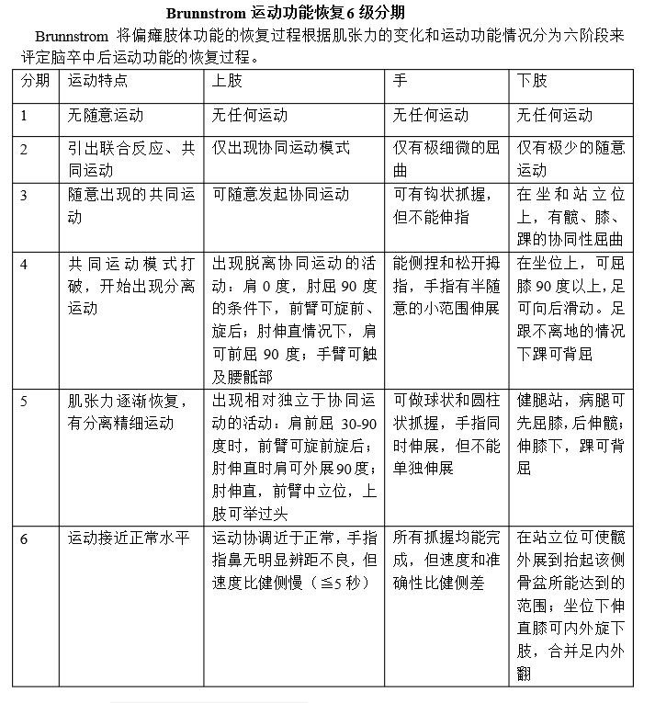

Slide 6
Materials and Methods
1. Participants
(2) Exclusion criteria
(a) Having a Montreal Cognitive Assessment (MoCA) score <16.
(b) Having visual or auditory impairment with the inability to clearly see or hear the feedback from the game.
(c) Having severe spasticity of lower extremity (Modiﬁed Ashworth Scale >= 3).
(d) Having other medical symptoms that could affect movement.

Slide 7


Slide 8
Materials and Methods
2. Design
(1) 90 minutes a session, twice a week for 6 weeks
(2) Standard Treatment (ST) group (each session)
(a) 45 minutes of the ST rehabilitative protocol (hip and knee strengthening, cycle, treadmill, hand functional training ).
(b) 15 minutes of exercises to increase soft tissue ﬂexibility.
(c) 30 minutes of functional balance exercises (weight shifting exercises, postural transition, single-legged stance, improve attention).
(3) VR group(each session)
(a) 45 minutes of the ST rehabilitative protocol.
(b) 15 minutes of warm up.
(c) 15 minutes each for two selected games.

Slide 9
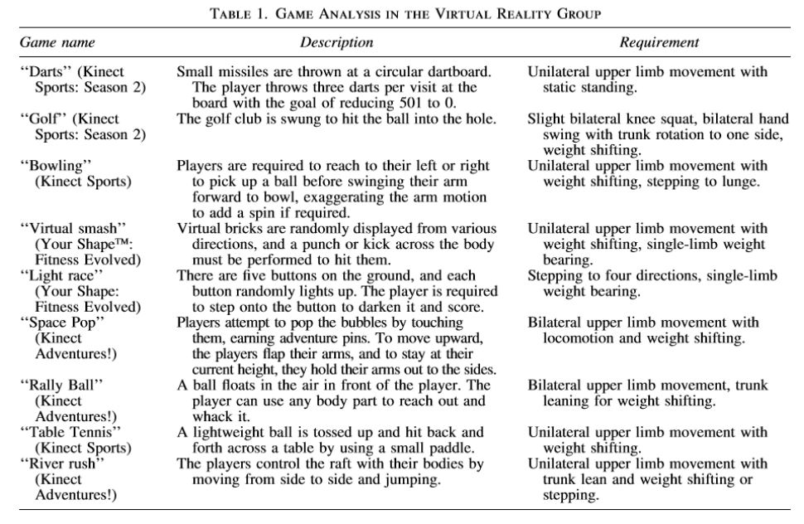

Slide 10
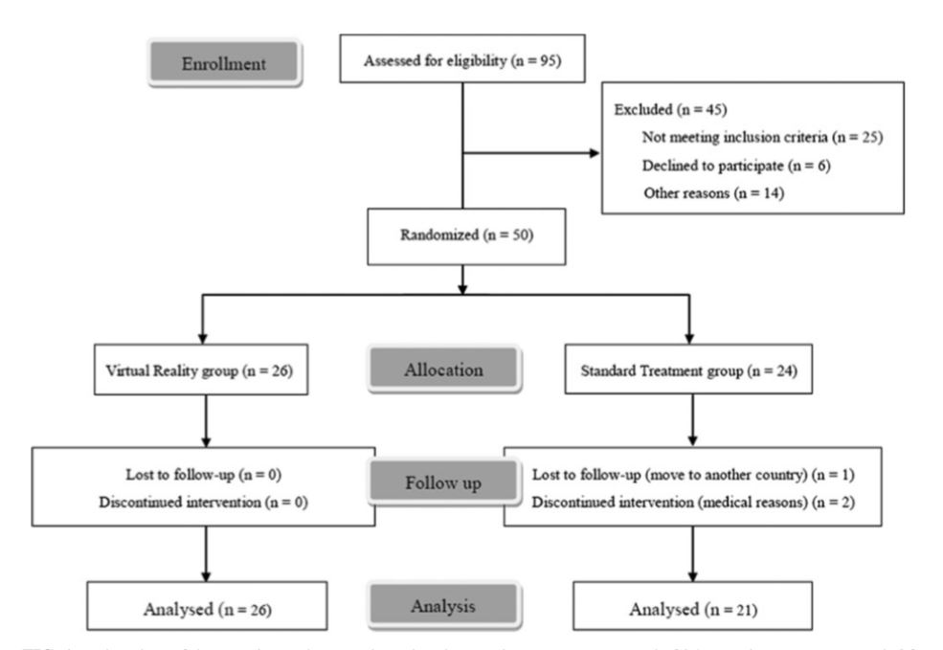

Slide 11
Outcome Measures
1. Berg Balance Scale (BBS) for balance
2. Functional Reach Test (FRT) for balance
3. Timed Up and Go-cognition (TUG-cog) for balance
4. Modiﬁed Barthel Index (MBI) for ADL
5. Activities-speciﬁc Balance Conﬁdence (ABC) for balance conﬁdence
6. Stroke Impact Scale (SIS) for QOL
7. Modiﬁed Physical Activity Enjoyment Scale (M-PAES) for feasibility
8. Incidence of adverse events (soreness, motor sickness, pain, injury, fall accident)

Slide 12
Results
A signiﬁcant time effect was observed in both groups in BBS (P=0.000) and TUG-cog (P=0.009).
M-PAES scores signiﬁcantly differed between the two groups (P=0.027).
No signiﬁcant improvement was observed in balance conﬁdence, ADL, or QOL.

Slide 13
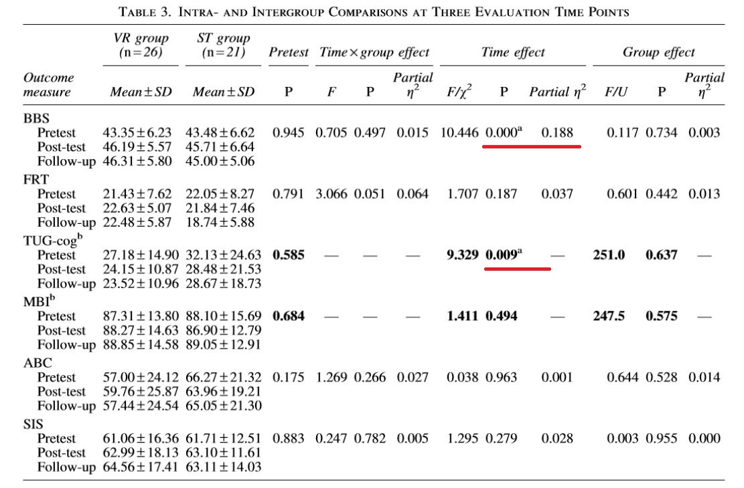

Slide 14
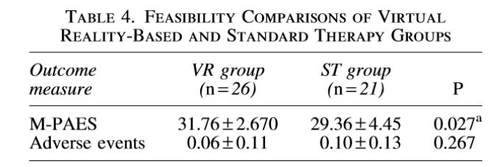

Slide 15
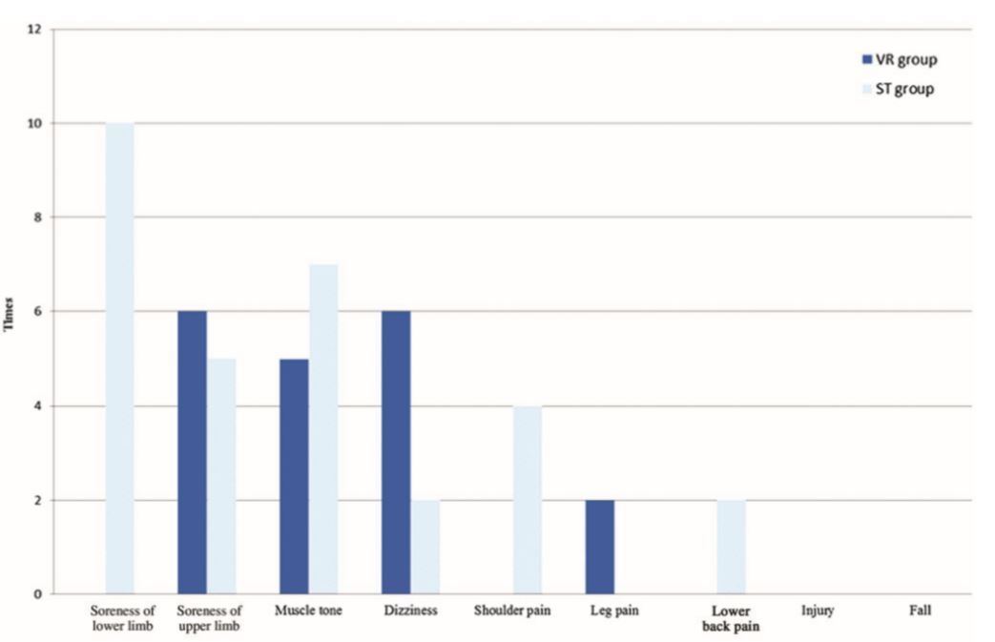

Slide 16
Conclusion
1. VR balance training by using Kinect for Xbox games plus the traditional method had positive effects on the balance ability of patients with chronic stroke, and the effects could be maintained after 3 months.
2. The level of pleasure experienced by the VR group was higher than that experienced by the ST group during intervention.

Slide 17
Limitations
1. We did not withhold routine rehabilitation therapy.
1. The lack of tight control on the speciﬁc tasks performed during routine therapy.

